Slide 1
Access Control Lists
Chapter 7

Slide 2
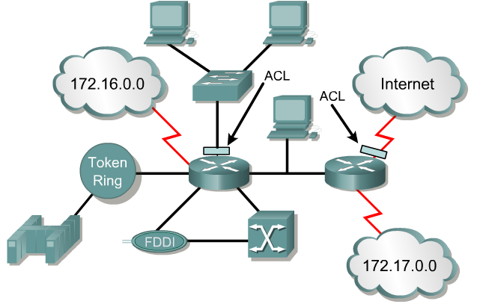
What are ACLs?
An access list is a sequential series of commands or filters.
These lists tell the router what types of packets to:
  accept or
  deny
Acceptance and denial can be based on specified conditions.
ACLs applied on the router's interfaces.

Slide 3
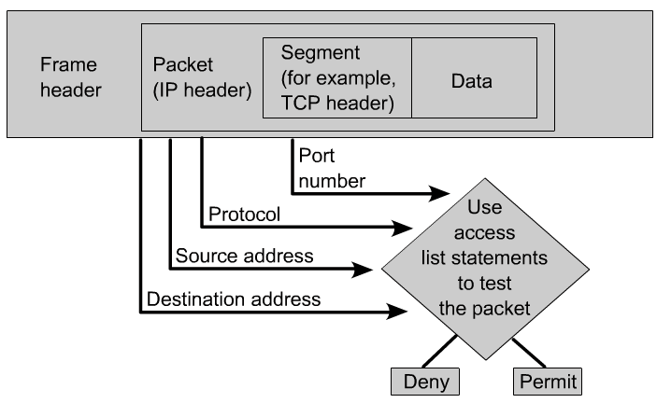
What are ACLs?
The router examines each packet to determine whether to forward or drop it, based on the conditions specified in the ACL.
Some ACL decision points are:
  IP source address
  IP destination addresses
  UDP or TCP protocols
  upper-layer (TCP/UDP) port numbers

Slide 4
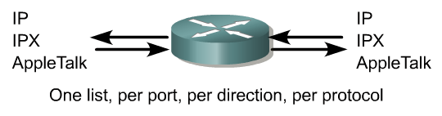

What are ACLs?
ACLs must be defined on a:
  per-protocol (IP, IPX, AppleTalk)
  per direction (in or out)
  per port (interface) basis.
ACLs control traffic in one direction at a time on an interface.
A separate ACL would need to be created for each direction, one for inbound and one for outbound traffic.
Finally every interface can have multiple protocols and directions defined.

Slide 5
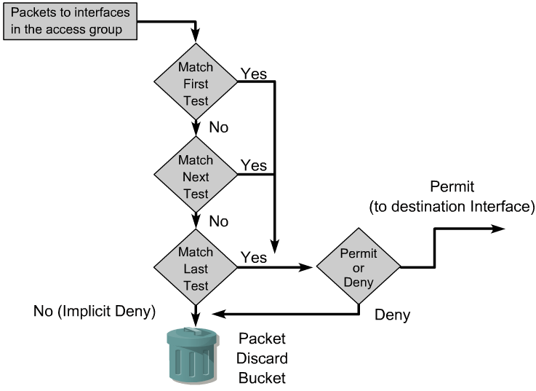
How ACLs work?
An ACL is a group of statements that define whether packets are accepted or rejected coming into an interface or leaving an interface.
Access list statements operate in sequential, logical order.
They evaluate packets from the top down.

Slide 6
How ACLs work?
Once there is an access list statement match, the packet skips the rest of the statements.
  If a condition match is true, the packet is permitted or denied.
There can be only one access list per protocol per interface.
There is an implicit “deny any” at the end of every access list.
If all the ACL statements are unmatched, an implicit "deny any" statement is placed at the end of the list by default. (not visible)
ACLs do not block packets that originate within the router. (ie. pings, telnets, etc.)

Slide 7
Two types of ACLs
Standard IP ACLs
  Can only filter on source IP addresses
Extended IP ACLs
  Can filter on:
    Source IP address
    Destination IP address
    Protocol (TCP, UDP)
    Port Numbers (Telnet – 23, http – 80, etc.)
    and other parameters

Slide 8
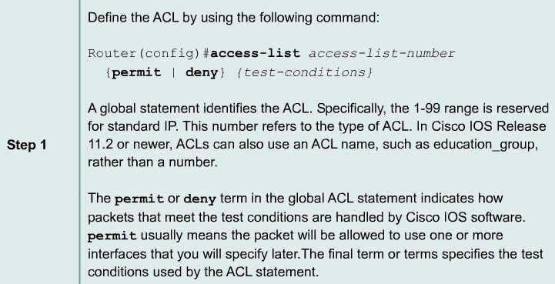
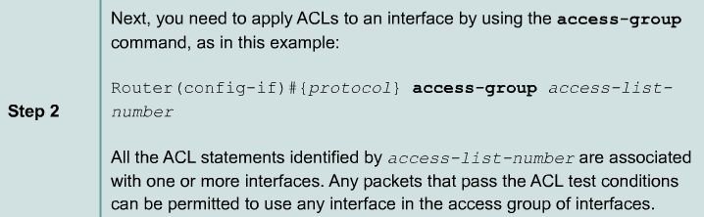
Creating Standard ACLs – 2 Steps

Slide 9
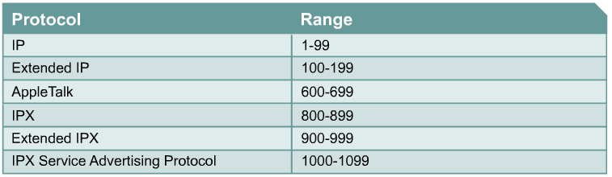
Creating ACLs – 2 Steps
(Standard IP)

Slide 10
Learn by example!
Task:
  Permit only the host 172.16.30.2 from exiting the Sales network.
  Deny all other hosts on the Sales network from leaving the 172.16.30.0/24 network.

Slide 11
Learn by example!
Step 1 – ACL statement to permit only 1 PC
RouterB(config)#access-list 10 permit 172.16.30.2
Step 2- Implicit “deny any”
RouterB(config)#access-list 10 deny 0.0.0.0 255.255.255.255

Slide 12
Learn by example!
Applying ACLs
You can define ACLs without applying them.
However, the ACLs will have no effect until they are applied to the router's interface.
It is a good practice to apply the Standard ACLs on the interface closest to the destination of the traffic and Extended ACLs on the interface closest to the source.
Defining In, Out, Source, and Destination
  Out - Traffic that has already been routed by the router and is leaving the interface
  In - Traffic that is arriving on the interface and which will be routed

Slide 13
Learn by example!
Step 2 – Apply to an interface(s)
RouterB(config)#access-list 10 permit 172.16.30.2
RouterB(config)#access-list 10 deny 0.0.0.0 255.255.255.255
RouterB(config)# interface e 0
RouterB(config-if)# ip access-group 10 in

Slide 14
Learn by example!
X
Step 2 – Or the outgoing interfaces… Which is preferable and why?
RouterB(config)#access-list 10 permit 172.16.30.2
RouterB(config)#access-list 10 deny 0.0.0.0 255.255.255.255
RouterB(config)# interface s 0
RouterB(config-if)# ip access-group 10 out
RouterB(config)# interface s 1
RouterB(config-if)# ip access-group 10 out

Slide 15
Learn by example!
Preferred, this access list will work to all existing and new interfaces on RouterB.
RouterB(config)#access-list 10 permit 172.16.30.2
RouterB(config)#access-list 10 deny 0.0.0.0 255.255.255.255
RouterB(config)# interface e 0
RouterB(config-if)# ip access-group 10 in

Slide 16
Example 2
Task:
  Permit only the hosts 172.16.30.2, 172.16.30.3, 172.16.30.4, 172.16.30.5 from exiting the Sales network.
  Deny all other hosts on the Sales network from leaving the 172.16.30.0/24 network.

Slide 17
Example 2
Once a condition is met, all other statements are ignored, so the implicit deny any only applies to not-matched packets.
RouterB(config)#access-list 10 permit 172.16.30.2
RouterB(config)#access-list 10 permit 172.16.30.3
RouterB(config)#access-list 10 permit 172.16.30.4
RouterB(config)#access-list 10 permit 172.16.30.5
RouterB(config)#access-list 10 deny 0.0.0.0 255.255.255.255 (implicit deny)
RouterB(config)# interface e 0
RouterB(config-if)# ip access-group 10 in

Slide 18
Example 2
To remove an Access List, use the no access-list command. Removing the access-group only from the interface leaves the access list, but they are not currently being applied. Usually, best to remove it from both.
RouterB(config)#no access-list 10
RouterB(config)# interface e 0
RouterB(config-if)# no ip access-group 10 in

Slide 19
Example 3
Task:
  Deny only the host 172.16.30.2 from exiting the Sales network.
  Permit all other hosts on the Sales network to leave the 172.16.30.0/24 network.
Keyword “any” can be used to represent all IP Addresses.

Slide 20
“any” keyword
RouterA(config)#access-list 11 deny 0.0.0.0 255.255.255.255
Or
RouterA(config)#access-list 11 deny any
any = 0.0.0.0 255.255.255.255
Simply put, the any option substitutes 0.0.0.0 for the IP address and 255.255.255.255 for the wildcard mask.
This option will match any address that it is compared against.

Slide 21
“host” option
RouterB(config)#access-list 10 permit 192.168.1.100 0.0.0.0
RouterB(config)#access-list 10 permit host 192.168.1.100
The host option substitutes for the 0.0.0.0 mask.
This mask requires that all bits of the ACL address and the packet address match.
The host keyword precedes the IP address.
This option will match just one address.
172.16.10.100 0.0.0.0 replaced by host 172.16.10.100
192.168.1.100 0.0.0.0 replaced by host 192.168.1.100

Slide 22
Example 3
Order matters! What if these two statements were reversed? Does the implicit deny any ever get a match? No, the permit any will cover all other packets.
RouterB(config)#access-list 10 deny host 172.16.30.2
RouterB(config)#access-list 10 permit any
RouterB(config)# interface e 0
RouterB(config-if)# ip access-group 10 in

Slide 23
Example 3
Order matters! In this case all packets would be permitted, because all packets would match the first access list statement. Once a condition is met, all other statements are ignored. The second access list statement and the implicit deny any would never be used. This would not do what we want.
RouterB(config)#access-list 10 permit any
RouterB(config)#access-list 10 deny 172.16.30.2
RouterB(config)# interface e 0
RouterB(config-if)# ip access-group 10 in

Slide 24

Time for Wildcard Masks!
A wildcard mask address:
Tells how much of the packet’s source IP address (or destination IP address) needs to match for this condition to be true.
Access-lists need to use wildcard masks when defining a network. Subnet masks DO NOT work!

Slide 25
Example 4 – Using Wildcard Masks
Task:
  Want RouterA to permit entire sales network and just the 172.16.50.2 station.
  Deny all other traffic from entering Administrative network.

Slide 26
Example 4 – Using Wildcard Masks
RouterA(config)#access-list 11 permit 172.16.30.0 0.0.0.255
RouterA(config)#access-list 11 permit 172.16.50.2 0.0.0.0

Slide 27
Example 4 – Using Wildcard Masks
Don’t forget to apply the access-list to an interface.
RouterA(config)#access-list 11 permit 172.16.30.0 0.0.0.255
RouterA(config)#access-list 11 permit 172.16.50.2 0.0.0.0
RouterA(config)# interface e 0
RouterA(config-if)#ip access-group 11 out

Slide 28
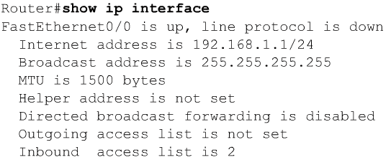
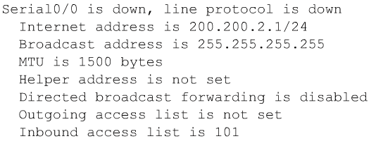
Verifying Access Lists

Slide 29
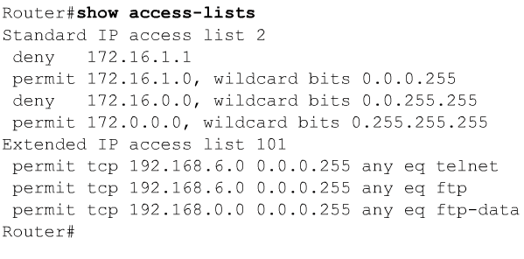
Verifying Access Lists

Slide 30

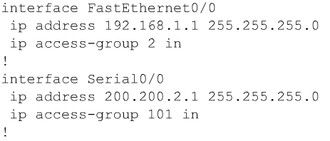
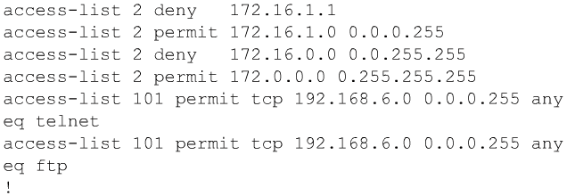
Verifying Access Lists
Note: More than one interface can use the same access-list.

Slide 31
Extended ACL

Slide 32
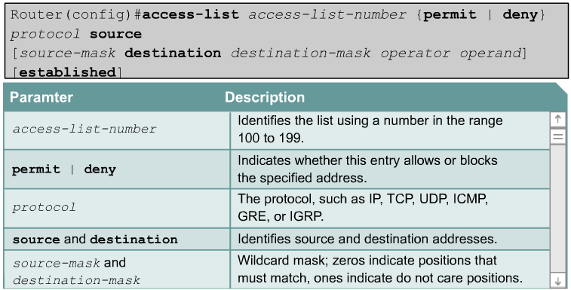
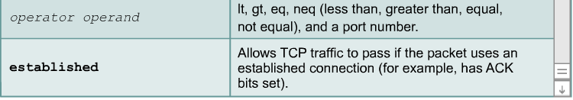
Extended Access Lists

Slide 33
Extended Access Lists
Extended ACLs are used more often than standard ACLs because they provide a greater range of control.
Extended ACLs check the source and destination packet addresses as well as being able to check for protocols and port numbers.
This gives greater flexibility to describe what the ACL will check.
Packets can be permitted or denied access based on where the packet originated and its destination as well as protocol type and port addresses.

Slide 34
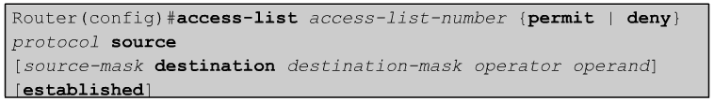
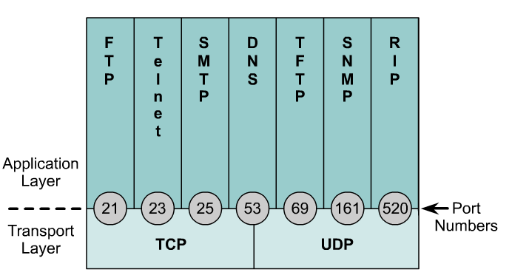
Extended Access Lists
Operator and operand can also refer to ICMP Types and Codes or whatever the protocol is being checked.
If the operator and operand follow the source address it refers to the source port
If the operator and operand follow the destination address it refers to the destination port.

Slide 35
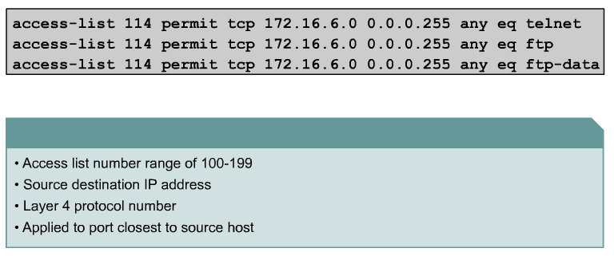
Extended Access Lists - Examples
port number or protocol name
The ip access-group command links an existing extended ACL to an interface.
Remember that only one ACL per interface, per direction, per protocol is allowed. The format of the command is:
Router(config-if)#ip access-group access-list-number {in | out}

Slide 36
Example 1
Port 80
Task
What if we wanted Router A to permit only the Engineering workstation 172.16.50.2 to be able to access the web server in Administrative network with the IP address 172.16.10.2 and port address 80.
All other traffic is denied.

Slide 37
Example 1
Port 80
RouterA(config)#access-list 110 permit tcp host 172.16.50.2 host 172.16.10.2 eq 80
RouterA(config)#inter e 0
RouterA(config-if)#ip access-group 110 out

Slide 38
Example 2
Port 80
Task
What if we wanted Router A to permit any workstation on the Sales network be able to access the web server in Administrative network with the IP address 172.16.10.2 and port address 80.
All other traffic is denied.

Slide 39
Example 2
Port 80
RouterA(config)#access-list 110 permit tcp 172.16.30.0 0.0.0.255 host 172.16.10.2 eq 80
RouterA(config)#inter e 0
RouterA(config-if)#ip access-group 110 out

Slide 40
Named ACLs
IP named ACLs were introduced in Cisco IOS Software Release 11.2.
Allows standard and extended ACLs to be given names instead of numbers.
The advantages that a named access list provides are:
  Intuitively identify an ACL using an alphanumeric name.
  Eliminate the limit of 798 simple and 799 extended ACLs
  Named ACLs provide the ability to modify ACLs without deleting and then reconfiguring them.
  It is important to note that a named access list will allow the deletion of statements but will only allow for statements to be inserted at the end of a list.
  Even with named ACLs it is a good idea to use a text editor to create them.

Slide 41
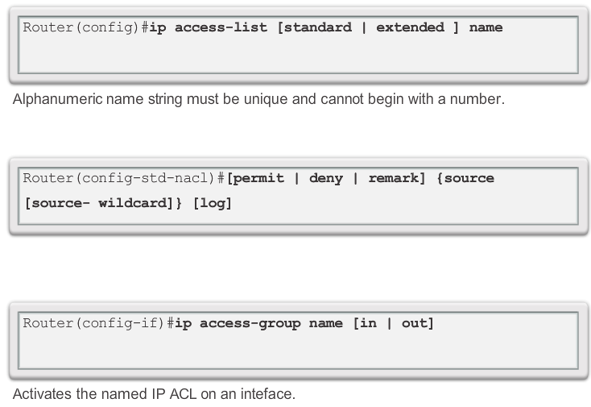
Creating Named Standard ACLs
Notes:
9.2.1.7 Creating Named Standard ACLs

Slide 42
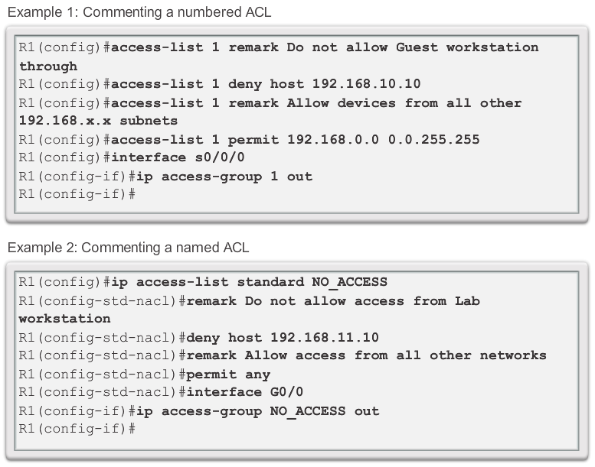
Commenting Named Std ACLs
Notes:
9.2.1.8 Commenting ACLs

Slide 43
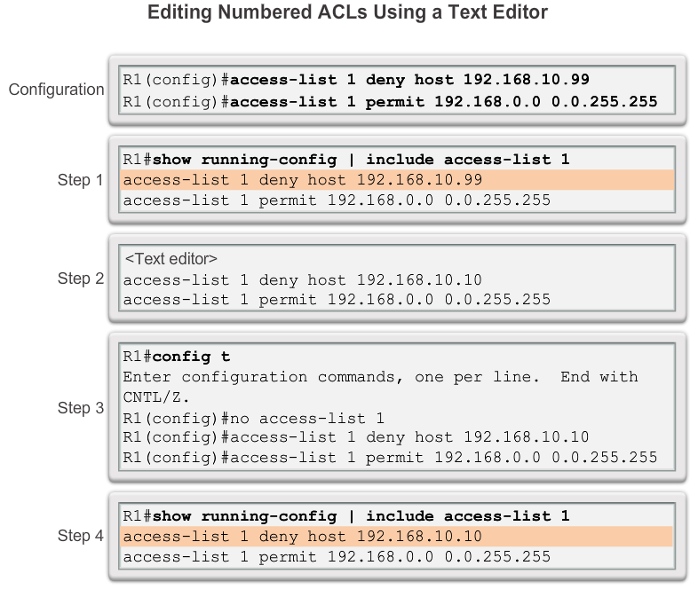
Editing Standard Numbered ACLs
Notes:
9.2.2.1 Editing Standard Numbered ACLs

Slide 44
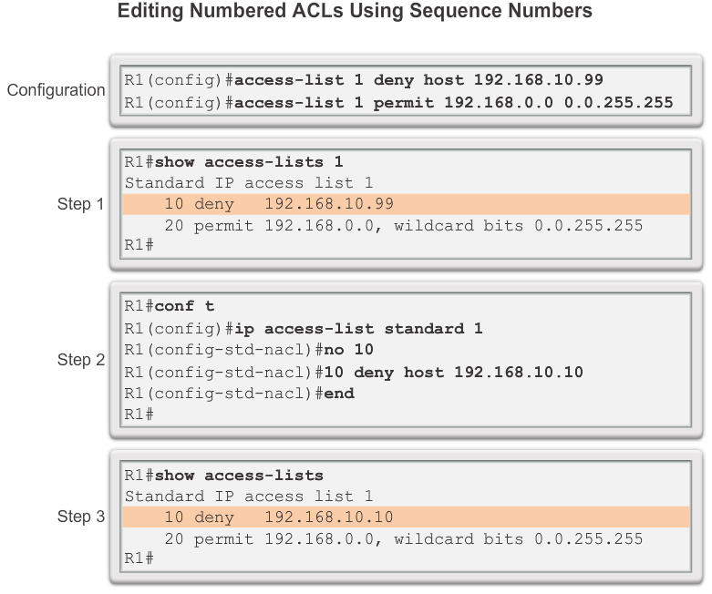
Editing Standard Numbered ACLs (cont.)
Notes:
9.2.2.2 Editing Standard Numbered ACLs (Cont.)

Slide 45
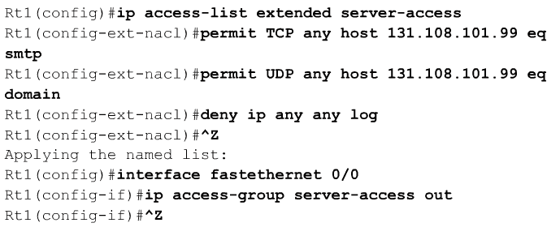
Named EXT ACLs
A named ACL is created with the ip access-list command.
This places the user in the ACL configuration mode.

Slide 46
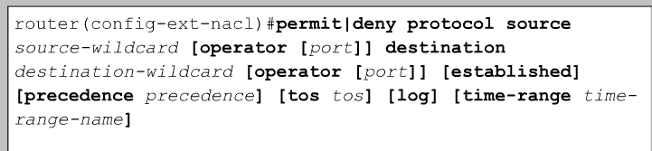
Named EXT ACLs
In ACL configuration mode, specify one or more conditions to be permitted or denied.
This determines whether the packet is passed or dropped when the ACL statement matches.

Slide 47
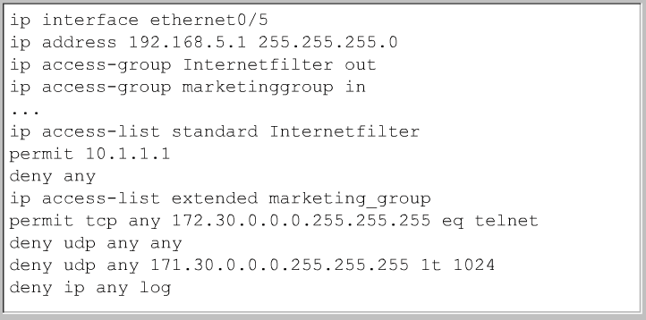

Named ACLs

Slide 48
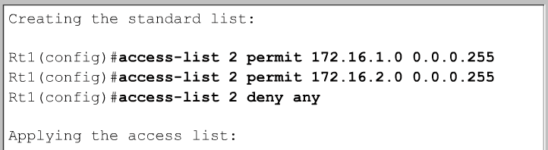
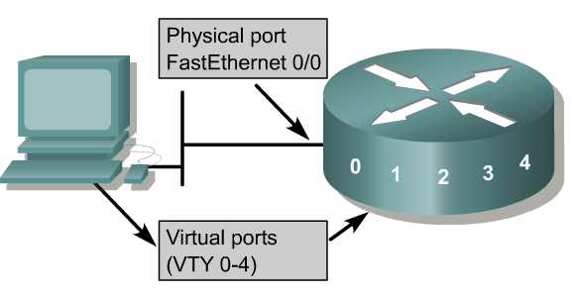
Restricting Virtual Terminal Access to a Router
Rt1(config)#line vty 0 5
Rt1(config-line)#login
Rt1(config-line)#password secret
Rt1(config-line)# access-class 2 in
The purpose of restricted vty access is increased network security.
Access to vty is also accomplished using the Telnet protocol to make a nonphysical connection to the router.
As a result, there is only one type of vty access list. Identical restrictions should be placed on all vty lines as it is not possible to control which line a user will connect on.

Slide 49
IPv6 ACLs

Slide 50
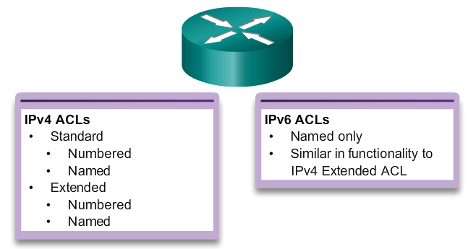
Type of IPv6 ACLs
Notes:
9.5.1.1 Type of IPv6 ACLs

Slide 51
Comparing IPv4 and IPv6 ACLs
Although IPv4 and IPv6 ACLs are very similar, there are three significant differences between them.
Applying an IPv6 ACL
  IPv6 uses the ipv6 traffic-filter command to perform the same function for IPv6 interfaces.
No Wildcard Masks
  The prefix-length is used to indicate how much of an IPv6 source or destination address should be matched.
Additional Default Statements
  permit icmp any any nd-na
  permit icmp any any nd-ns
Notes:
9.5.1.2 Comparing IPv4 and IPv6 ACLs

Slide 52
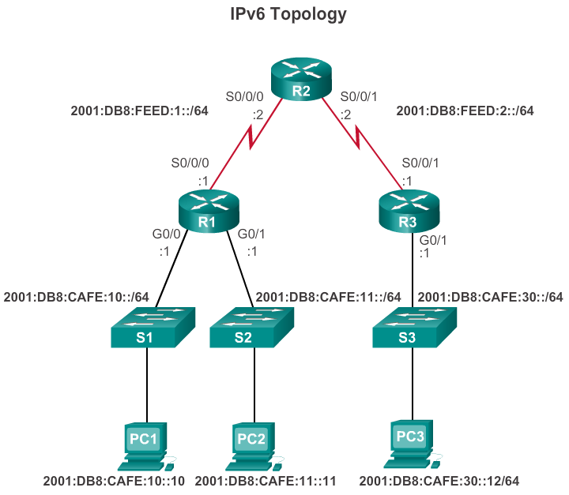
Configuring IPv6 Topology
Task 1: Deny all R3 LAN traffic from entering S0/0/0 of R1
Notes:
9.5.2.1 Configuring IPv6 Topology

Slide 53
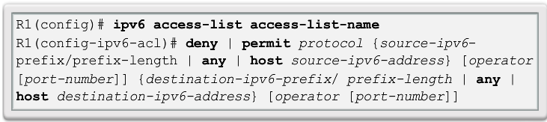
Configuring IPv6 ACLs
There are three basic steps to configure an IPv6 ACL:
From global configuration mode, use the ipv6 access-list name command to create an IPv6 ACL.
From the named ACL configuration mode, use the permit or deny statements to specify one or more conditions to determine if a packet is forwarded or dropped.
Return to privileged EXEC mode with the end command.
Notes:
9.5.2.2 Configuring IPv6 ACLs

Slide 54
Task 1: Deny R3 LAN traffic
R1(config)# ipv6 access-list NO-R3-LAN-ACCESS
R1(config-ipv6-acl)#deny ipv6 2001:db8:café:30::/64
R1(config-ipv6-acl)#permit ipv6 any any
R1(config-ipv6-acl)#end

Slide 55
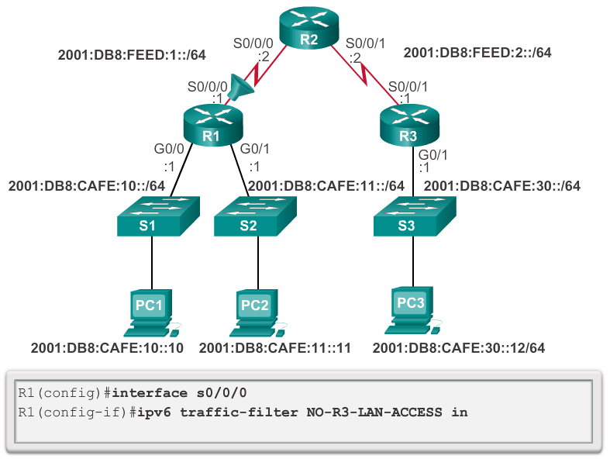
Applying an IPv6 ACL to an Interface
Notes:
9.5.2.3 Applying an IPv6 ACL to an Interface

Slide 56
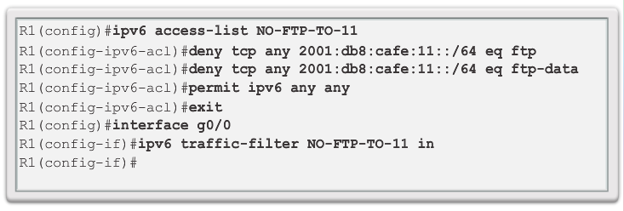
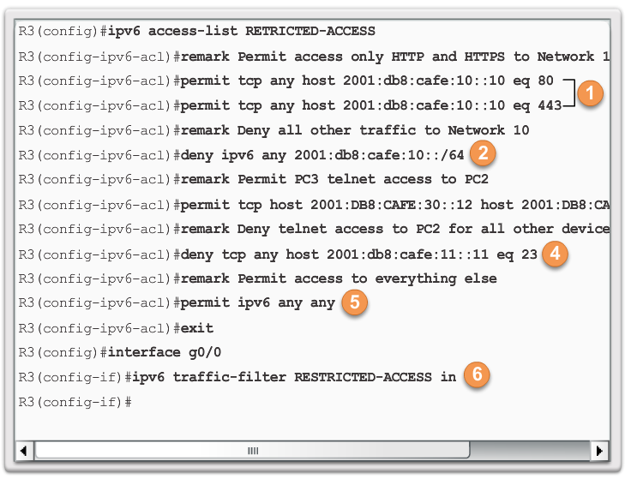
IPv6 ACL Examples
Deny FTP
Restrict Access
Notes:
9.5.2.4 IPv6 ACL Examples

Slide 57
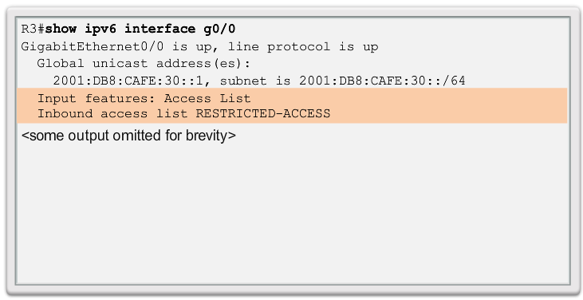
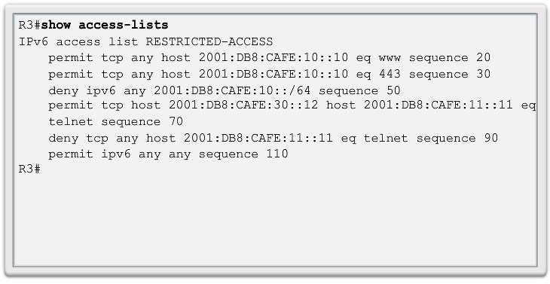
Verifying IPv6 ACLs
Notes:
9.5.2.5 Verifying IPv6 ACLs

Slide 58
THE END

